Slide 1

Performance-based Tolerance Specification for a
Centrifugal Pump Impeller
Michel Noaparast, Development Engineer
Tobias Randers Olesen, Development Engineer
Dr. Nicholas Pedersen, Senior Manager
GRUNDFOS PRODUCTS AND OFFERINGS
Notes:
We are from hyd. development, etc. Etc, working with bla bla – putting it in context

Slide 2

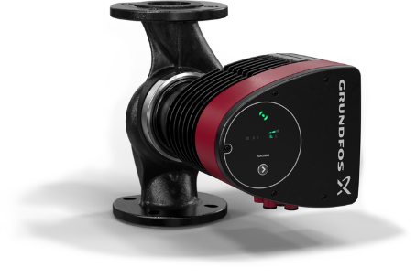
#1
74
83
Pump manufacturer in the world
Years old (founded in 1945)
Companies across the world
16
19
Million units produced every year
Thousand employees worldwide
Companies
3.6
1
Turnover (billion Euros) 2018
Owner

Slide 3
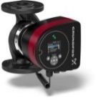
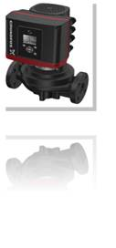
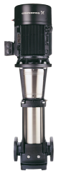
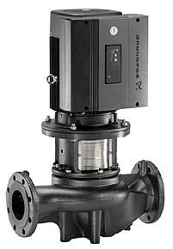
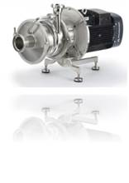
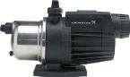
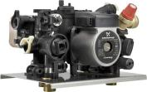
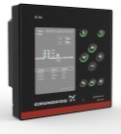
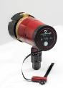
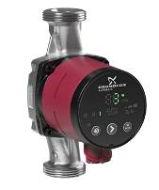
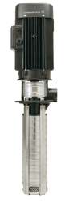
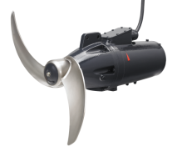
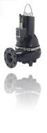
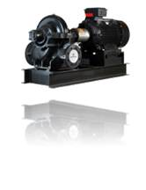
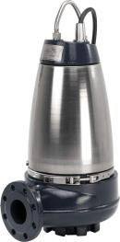
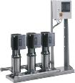
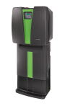
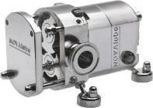
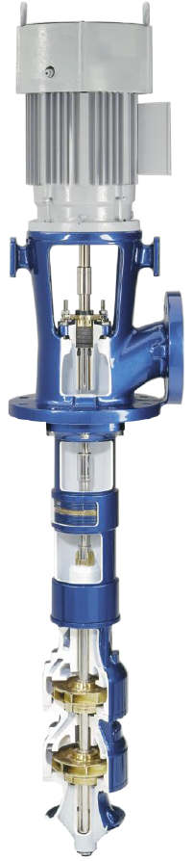
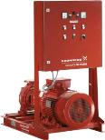
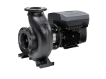
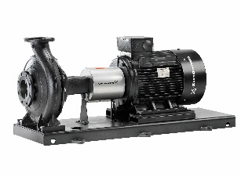
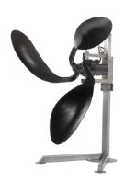
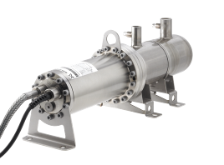
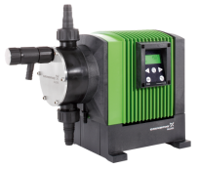
GRUNDFOS PRODUCT RANGE

Slide 4
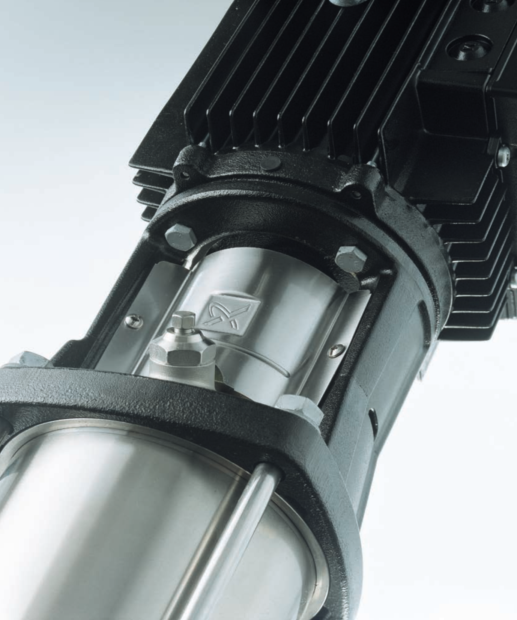
Contents
Motivation
Simulation set-up
Parametrization
Perturbation method
OptiSLang set-up
Results
Conclusion

Slide 5
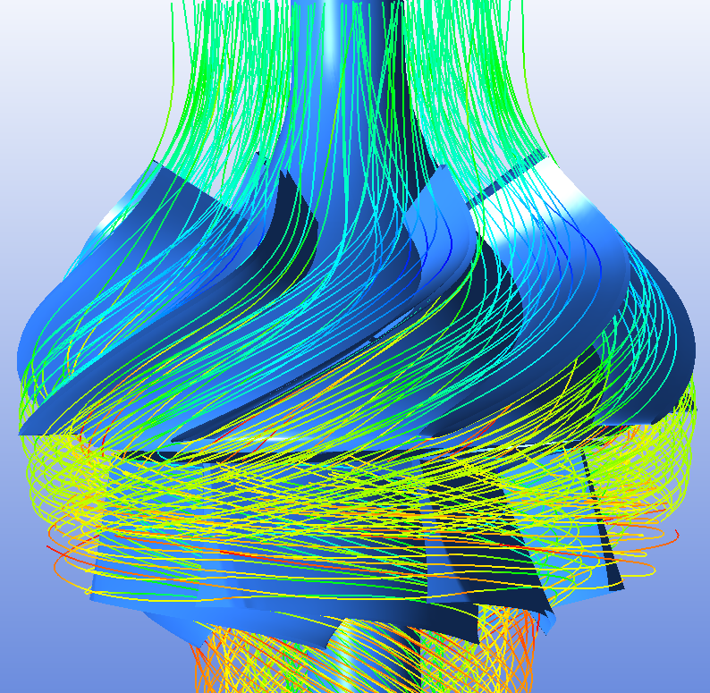
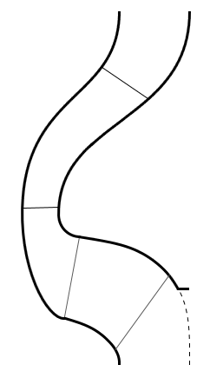
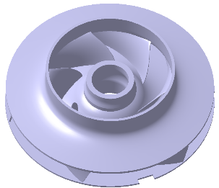
1. Motivation Development process
Hydraulic designer
Tolerance specialist
?

Slide 6
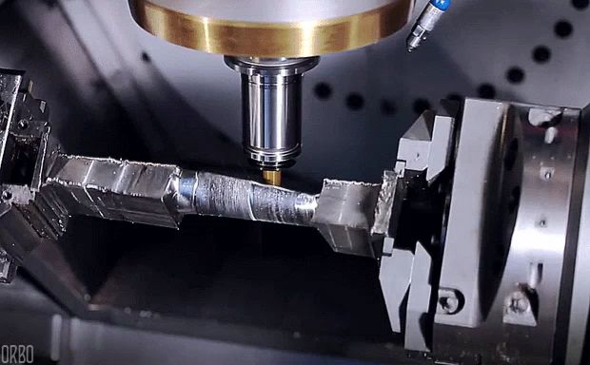
Tooling specialist

Slide 7
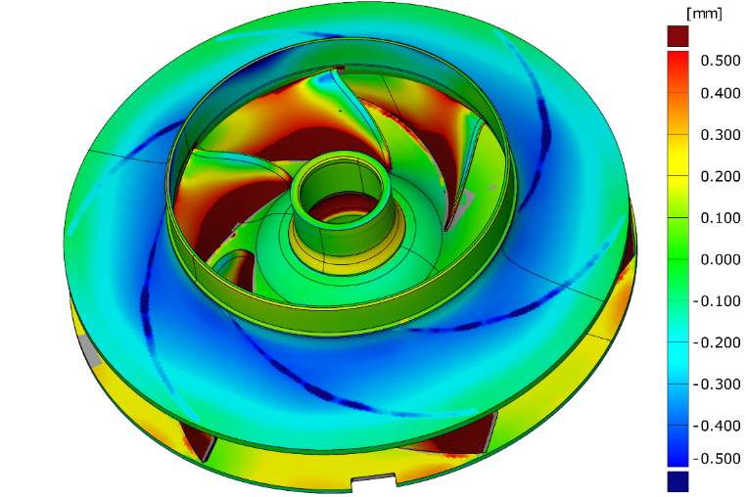
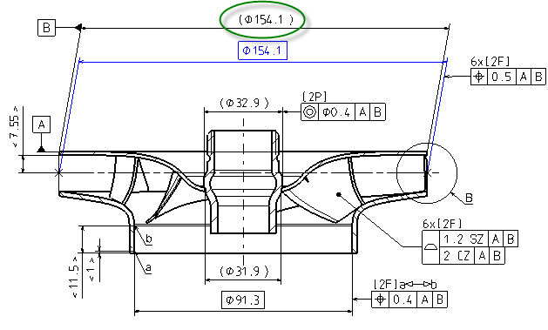
1. Motivation Development process
Hydraulic designer
Tolerance specialist
Produced component
with deviations

Slide 8


Motor limit

Slide 9
Variations are unavoidable
so how do we control them?
so how do we predict their impact?
so how can we reduce their impact?
Hypothesis
Can be done by replacing traditional tolerances with tolerance zones based on sensitivity studies.

Slide 10
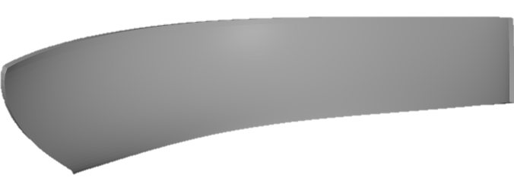
Hypothesis
Can be done by replacing traditional tolerances with tolerance zones based on sensitivity studies.
+/- 0.3 mm
+/- 0.1 mm
+/- 0.5 mm
+/- 0.1 mm

Slide 11
Solution
Robustness evaluation
Create mesh
Perturb geometry
Perform CFD
OptiSLang/DoE

Slide 12
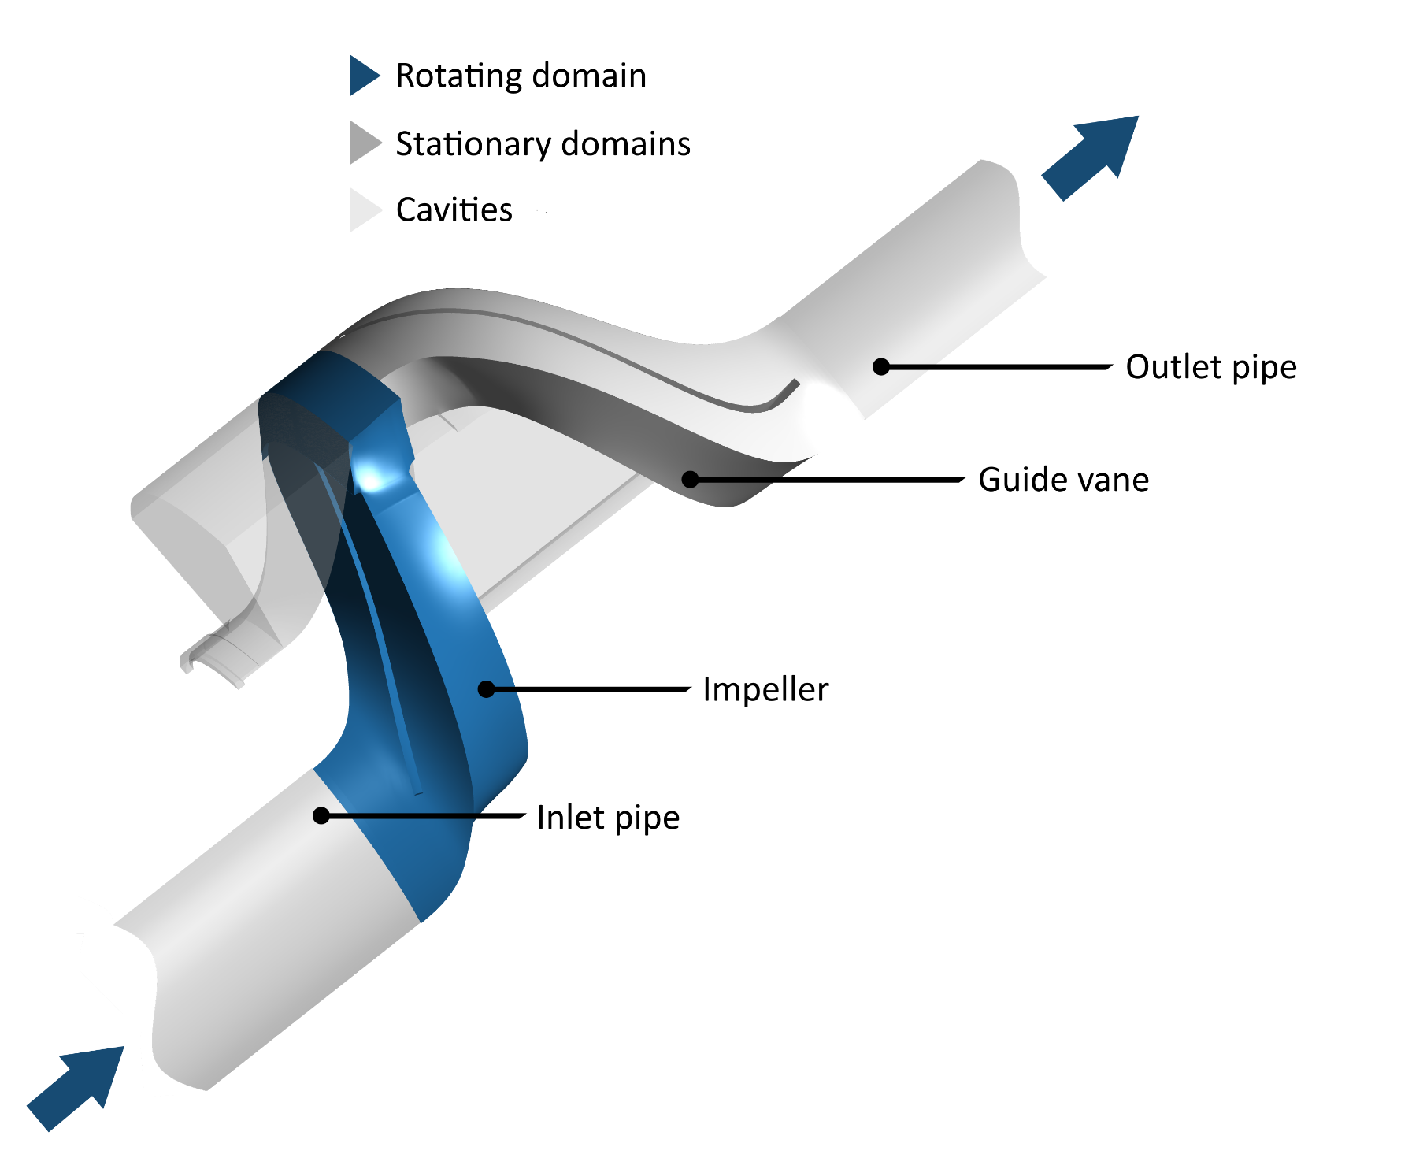
2. Simulation set-up Fluid domain
Periodic symmetry -> Single channel domain
Components:
Front cavity
Back cavity
Impeller
Guide vane
Inlet pipe
Outlet pipe

Slide 13
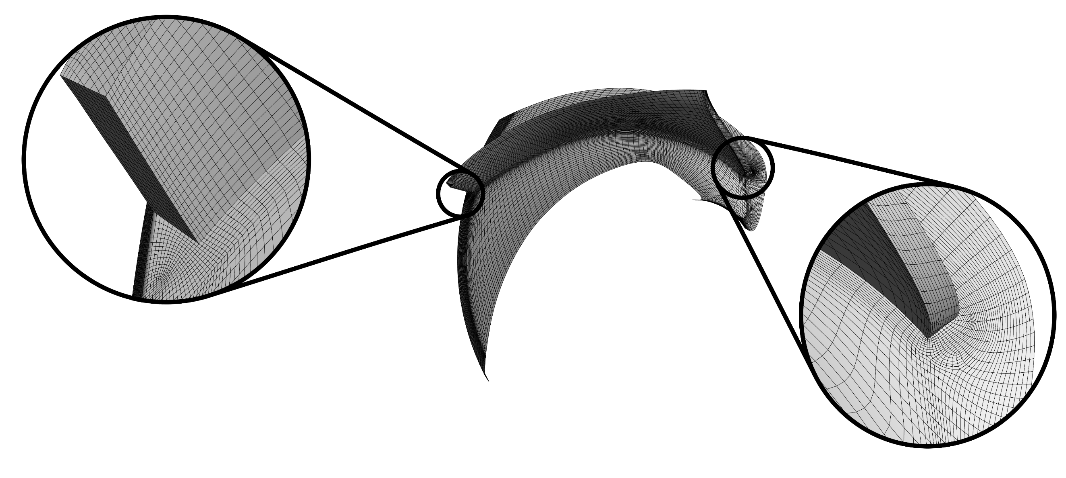
2. Simulation set-up Mesh properties
 | Cell count | Min. orthogonal angle
Front cavity | 88,683 | 46.9
Back cavity | 28,425 | 53.0
Impeller | 325,616 | 24.7
Guide vane | 121,312 | 27.5
Inlet pipe | 8,957 | 87.8
Outlet pipe | 12,337 | 87.6
GridPro v6.7
Structured hexahedral meshes

Slide 14
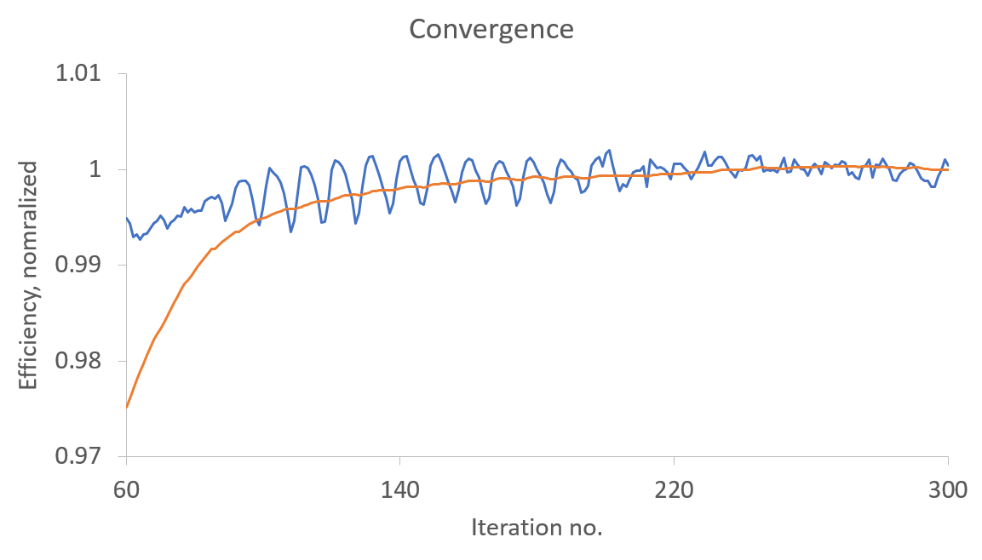
2. Simulation set-up CFD simulation
ANSYS CFX 2019 R1
Convergence good, averaged result
Good match between CFD and test
Averaged

Slide 15

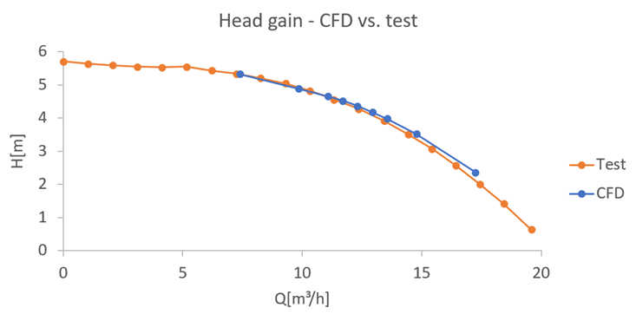
2. Simulation set-up CFD simulation
Averaged
ANSYS CFX 2019 R1
Convergence good, averaged result
Good match between CFD and test

Slide 16
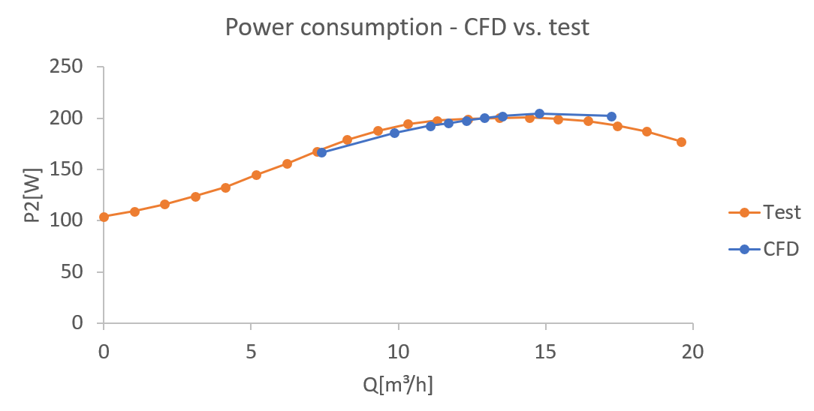
2. Simulation set-up CFD simulation
Averaged
ANSYS CFX 2019 R1
Convergence good, averaged result
Good match between CFD and test

Slide 17
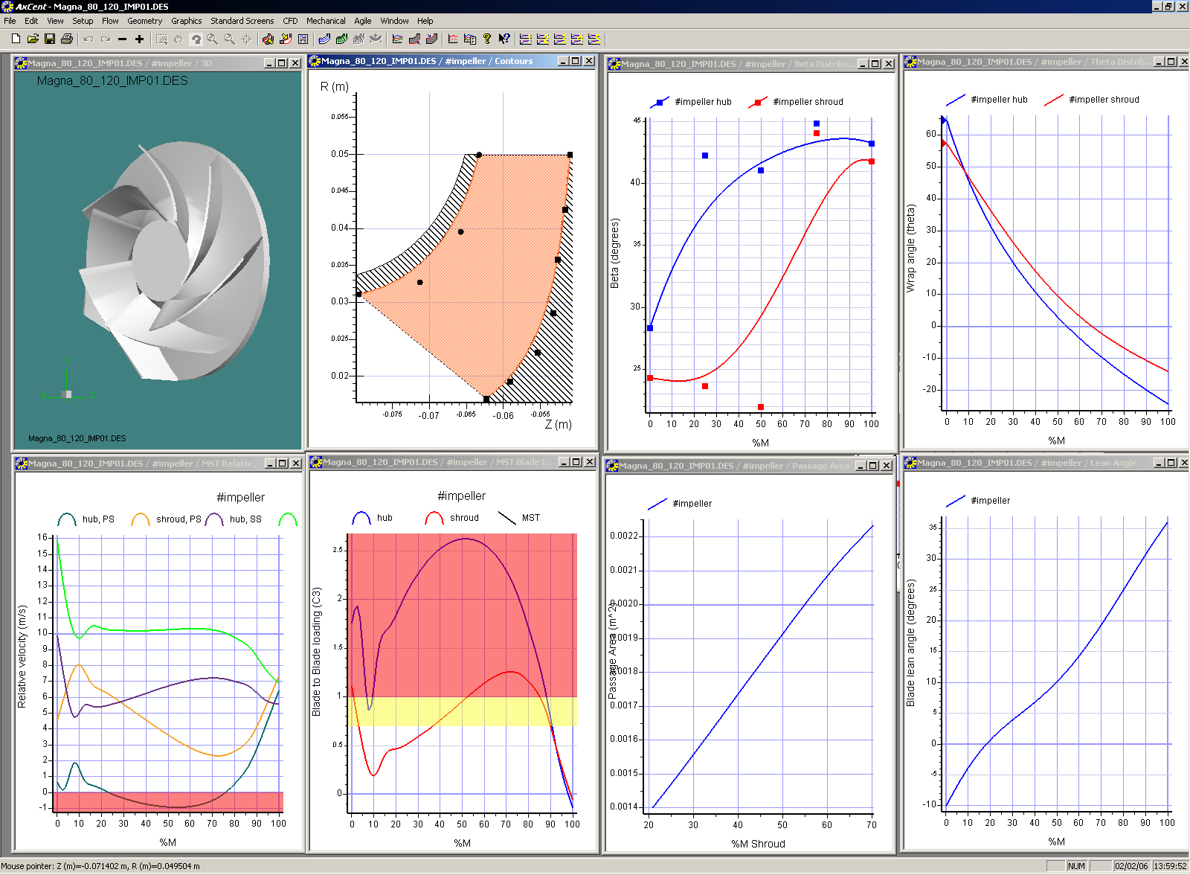
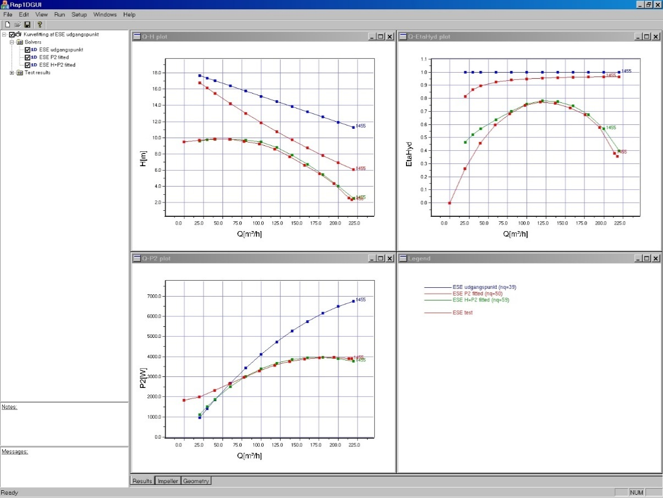
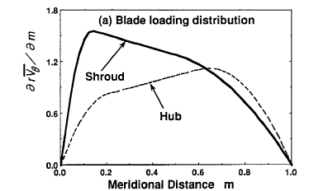
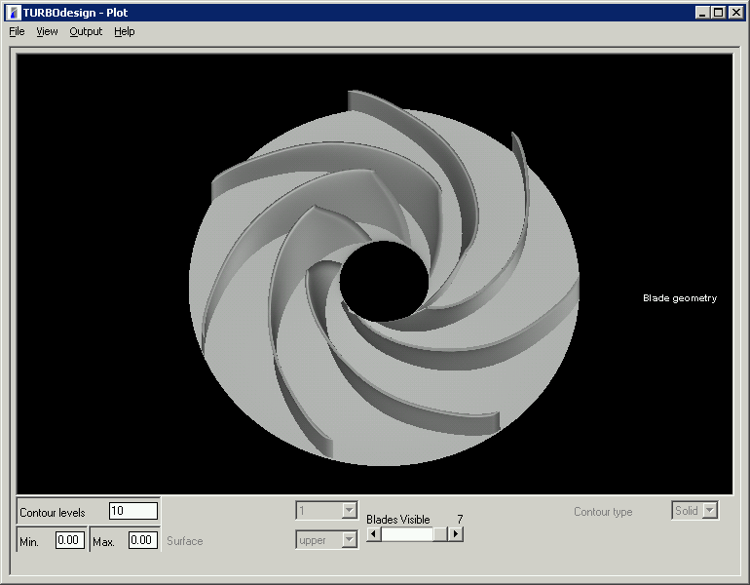
3. Parametrization Hydraulic design methods
Conventional hydraulic design method
Direct specification of blade angle distribution
No direct specification of loading or performance
Not suited for imitating production variations
Inverse hydraulic design method
Specification of performance and blade loading (pressure difference across blade)
No direct specification of blade angles
Notes:
You could make geometric variations, but it would be difficult to impose stochastic variations seen in productions.

Slide 18
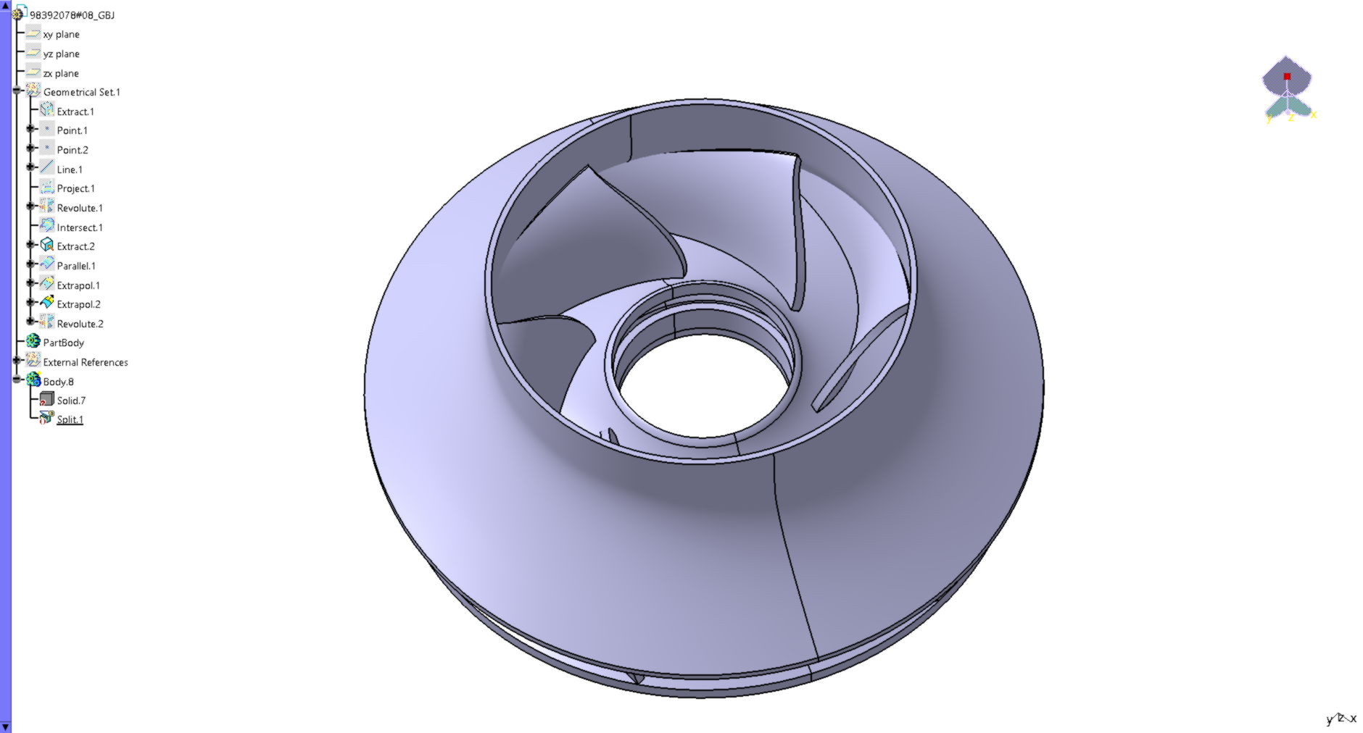
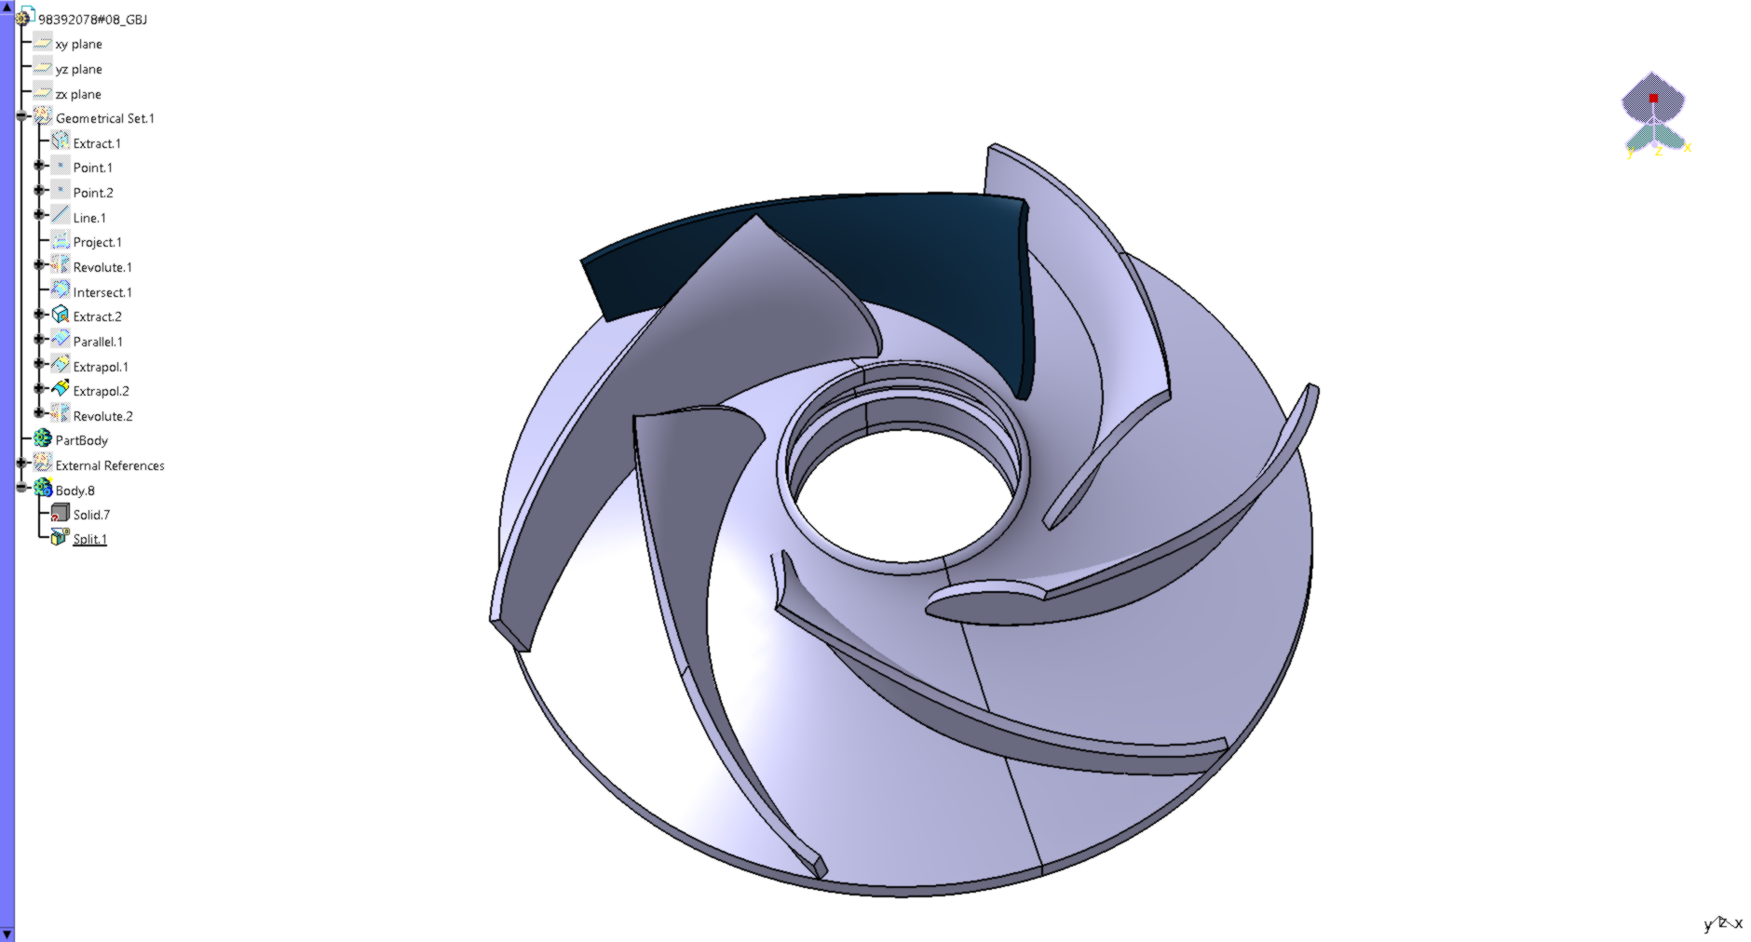
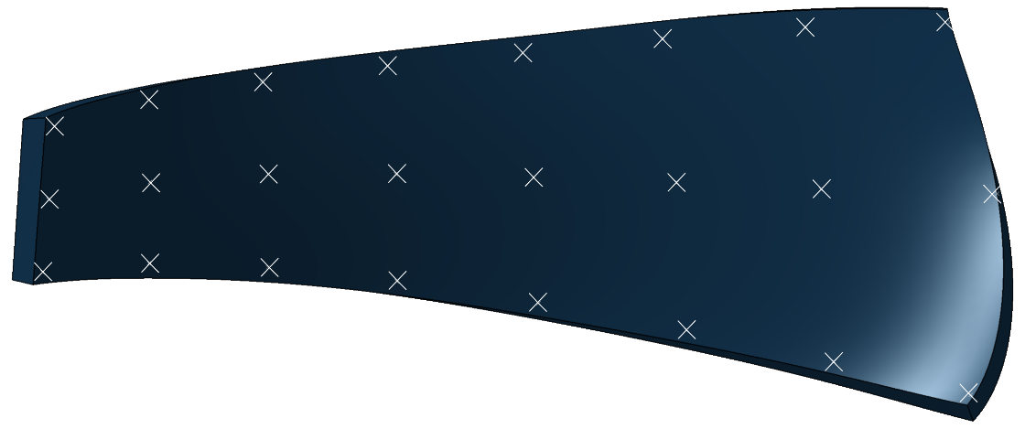
3. Parametrization Geometric parametrization
Advantages:
Parameters linked to geometry changes
Easy to impose tolerances
Easy to mimic specific production variations
Periodic symmetry -> Single blade
8x3 control points
Displacement normal to the surface
Constant blade thickness

Slide 19
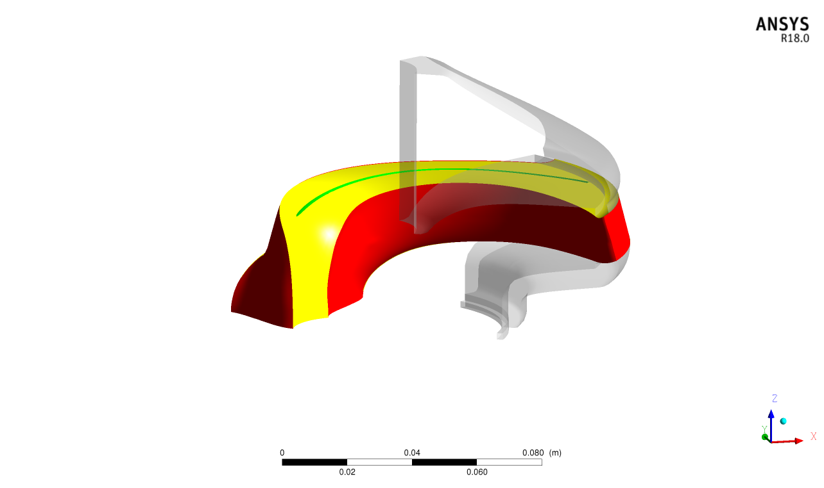
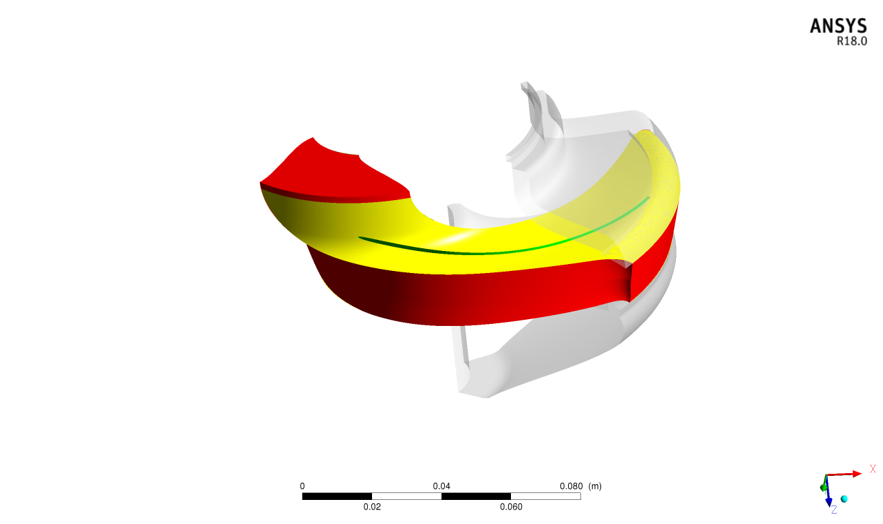
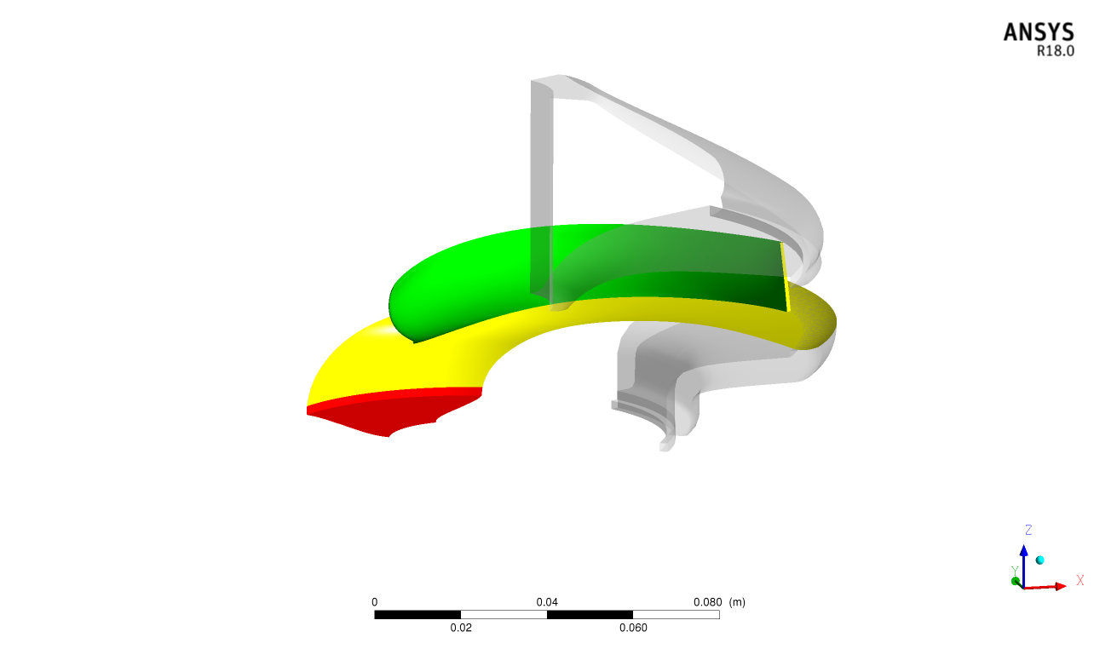
4. Perturbation method Mesh morphing
Green: Specified. Displacement is specified in input file.
Yellow: Unspecified. Soft constraint.
Red: Fixed. No modifications to mesh.

Slide 20
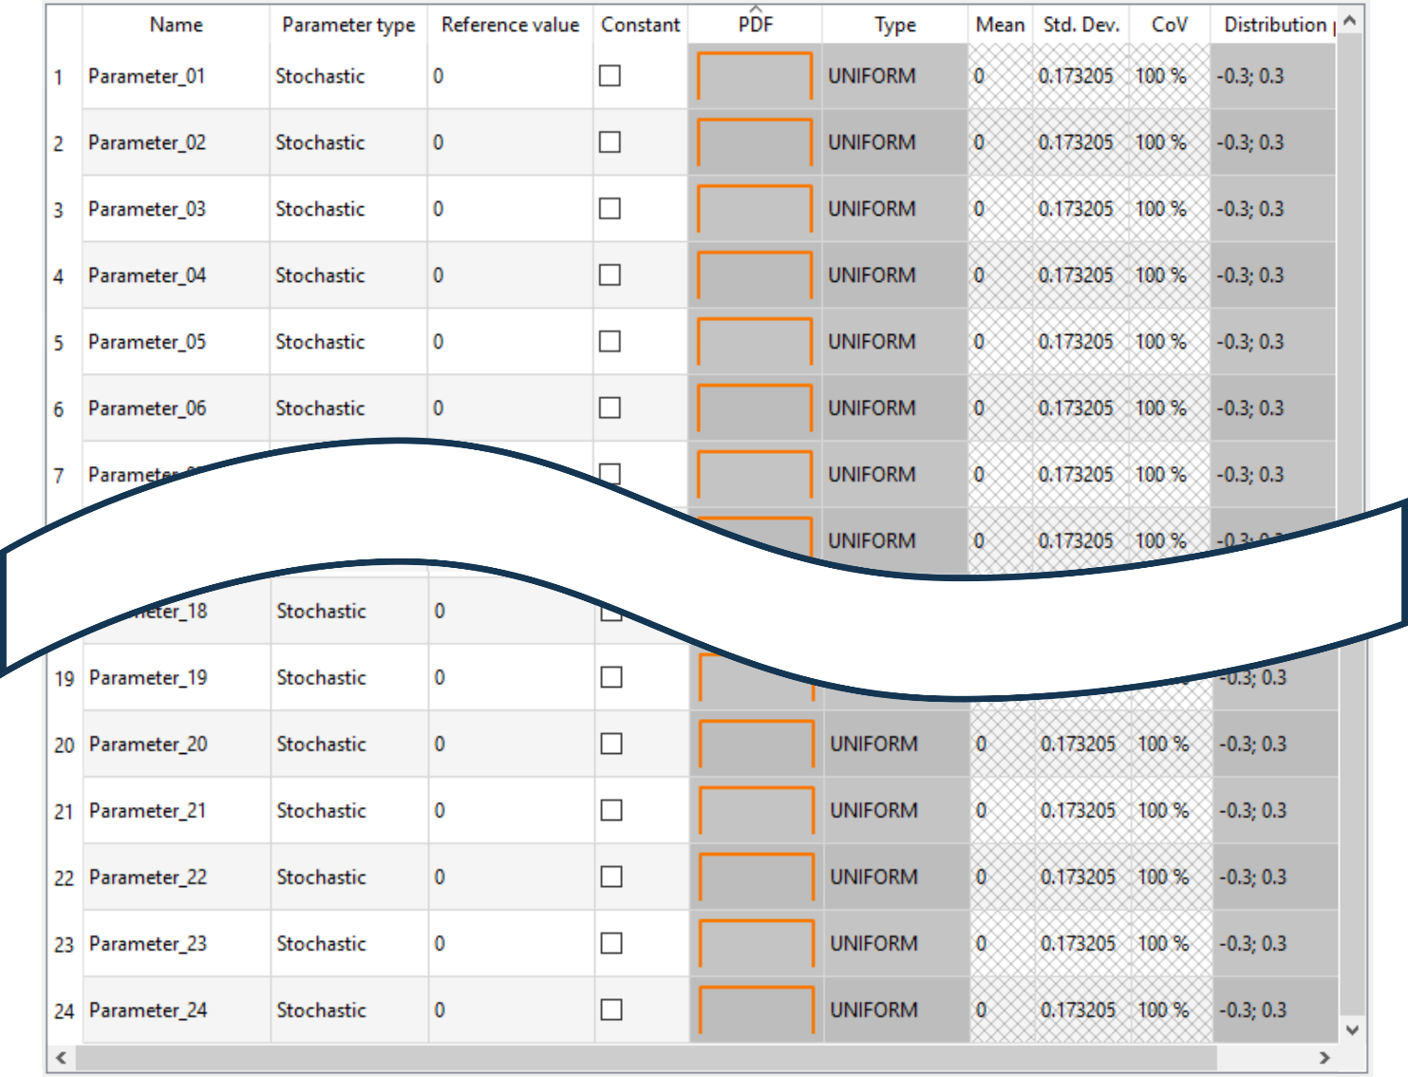

5. OptiSLang set-up Parameters
Robustness evaluation
24 points on blade surface
Advanced Latin Hypercube Sampling
100 samples (>2k)
Responses
Head
Power consumption
Efficiency
Minimum pressure

Slide 21


5. OptiSLang Solver call
Text-based solver (bash)
Python
Perturb geometry
Perform CFD
OptiSLang/DoE

Slide 22

6. Results Key statistics
Samples | Initial | 100
 | Failed
 | Removed
 | Remaining
CoP | Head
 | Power consumption
 | Efficiency
 | Minimum pressure

Slide 23





6. Results Visualization of the sensitivity
Head
P2
P_{min}
Eta

Slide 24
6. Results Adjusted tolerance zones
Prediction of tolerance impact
Peak difference: 80 W

Slide 25






6. Results Visualization of the sensitivity
The sensitivity for each output is extracted and normalized with the highest value for that output.
The normalized sensitivity data for all four outputs is added, with a maximum allowable value of one.
Head
Combined sensitivity
+/- 0.1 mm
+/- 0.5 mm
P2
+/- 0.1 mm
P_{min}
Eta

Slide 26


6. Results Adjusted tolerance zones

Slide 27
7. Conclusion
Sensitive regions identified
Tighten tolerances in important regions
Loosen tolerances in less important regions
Reduce complexity and/or increase performance
Estimated performance variations
Optimize tolerances and avoid over-engineering
Estimate required safety margins in design phase
New methodology
Applicable to any geometry

Slide 28
7. Conclusion
Sensitive regions identified
Tighten tolerances in important regions
Loosen tolerances in less important regions
Reduce complexity and/or increase performance
Estimated performance variations
Optimize tolerances and avoid over-engineering
Estimate required safety margins in design phase
New methodology
Applicable to any geometry
Next steps
Test on more geometries
Include in design procedures

Slide 29


